Slide 1

Good Tech Scholars Program StockIT App
Theme: Digital Transformation
for Social Change
1 oct 2021

Slide 2
Team
Mentors
Mamatha Venkatesh
Balakrishnan Rajenderan
Team members
Atul Vyshnav R
Krishnanand K
Aparna A
Kallu Sudarsan
Gokul S Pillai
Malavika S
RIT, Kottayam
‹#›

Slide 3
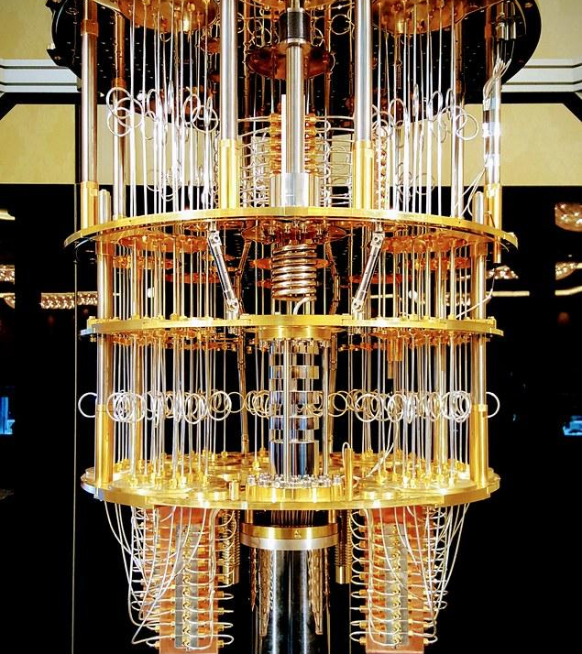
‹#›
Table of Contents
Problem Statement and its relevance
Solution Approach
Description
Features
Architecture diagram
Impact
Outcomes
Demo
Pre-recorded video
Future Scope
Q&A

Slide 4
Problem statement and relevance
Lack of common people's involvement in the Indian equities market.
Most indian investors lack a basic knowledge about the way stock market function.
Only less than 5% of the population is actively involved in stock market.
Lack of financial intelligence, trust and education are some of the reasons it isn't mainstream.
Problem
‹#›

Slide 5
Solution Approach
Description
An interactive platform that educates novice users with trade suggestions backed by ML predictions. It is a game like approach which helps the absolute beginners to master Stock market. It will make a same impact as made by the digital payment applications in India.
‹#›

Slide 6
Solution Approach
Features of StockIT App
Game based Intuitive approach to learning.
Mock trade sessions on real time charts
Simplified UI
ML price action prediction models
Education about owning stocks.
Access to equities, options trading etc., based on test scores.
Trading jargons explained in Layman's terms.
Zero commission model on trades.
‹#›

Slide 7
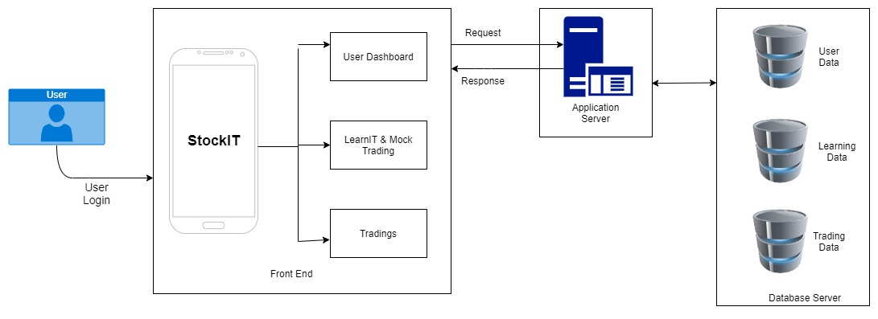
Solution Flow
ARCHITECTURE DIAGRAM
‹#›

Slide 8
Impact
Financial intelligence amongst people.
A
People can achieve financial freedom.
B
C
Increase in GDP and Liquidity.
‹#›

Slide 9
Outcomes
Increase in active investors in Indian market.
A
B
More investment in domestic companies.
C
More employment opportunities.
‹#›

Slide 10
Demo
https://drive.google.com/file/d/1bdLAzCi1y768R76-oHXw-gVVgeJkFO35/view?usp=sharing

Slide 11
Future scope
Personalized action alerts can be incorporated.
A fully fledged card game can be made with an advanced animated version.
Can add more number of indicators in the subsequent levels & performance can be improved with integration with ML.
Can include Crypto exchanges.
Mobile based trading has made stock market accessible to investors in small town.
With the proliferation of smart phone and mobile data consumption, it will gain popularity among the people.
‹#›

Slide 12
Q&A
‹#›

